Slide 1
MECM: Capabilities Exposure Solution
Gaurav Agrawal, Shashikanth

Slide 2
Requirement Overview
Requirements
On Portal List Platform capabilities like service provided by MEC applications, locations, network etc.
On portal List Hardware Capabilities including GPU/ NPU etc. (only externally configured value, not available one)
Capabilities display per edge
List of consumers per capability per edge.
TBD: List of capabilities used per application
Capabilities Registration/ Exposure
Hardware Capabilities – Registers as external system to MECM-Inventory by administrator and exposed by MECM-Inventory
Platform Capabilities – Registered to MEP over MP1 and obtained via MM5
Future Considerations
1. Usage of these capabilities during Orchestration
2. Maintain Availabile inventory for these capabilities by dynamically getting the initial & current usage/availability status.
Notes:
https://gitee.com/edgegallery/community/blob/master/Security%20WG/Tutorials/Gitee%20Pull%20Request%20Compliance%20Verification.md

Slide 3
HW Capability Exposure Solution
1
Registers HW Capabilities
Existing API, Parameter Additions
POST /inventory/v1/tenants/{tenant_id}/mechosts
PUT /tenants/{tenant_id}/mechosts/{mechost_ip}
MECM-FE
Additional Input
{
"hwcapabilities": {
"type": "GPU",
"vendor": "testvendor",
"model": "testmodel",
"specification": [
{
"spectype": "noofcards",
"specvalue": "2"
}
]
}
}
public class HwCapability { private String type; private String vendor; private String model; private HwSpecs specs; } public class HwSpecs { private List<HwSpec> specs; }
public class HwSpec { private String spectype; private String specvalue; }
Application Instantiation
with HW capabilities details
Get per node HW Capabilities
Get per node/per capability consumers
2
4a
4b
1
MECM-APPO
MECM-Inventory
3
Add to Inventory
2
Application Instantation
3
Add to Inventory
4a
Get per node HW capability
Existing API, Parameter Additions
POST /appo/v1/tenants/{tenant_id}/app_instances
Additonal Variable:
List<HwCapabilities>
{
hwcapabilities: [capability1, capability2]
}
NEW API
GET /tenants/{tenant_id}/mechosts/ {mechost_ip}/app
{
“appid” : “id1”,
“appname: “appname1”
“capabilities”: [capabilityType1, capabilityType2]
}
NEW API
GET /tenants/{tenant_id}/mechosts/ {mechost_ip}/capabilities
Additional Output
{
"hwcapabilities": {
"type": "GPU",
"vendor": "testvendor",
"model": "testmodel",
"specification": [
{
"spectype": "noofcards",
"specvalue": "2"
}
]
}
}
4b
Get per node per HW capability applications
NEW API
GET /tenants/{tenant_id}/mechosts/ {mechost_ip}/capabilities/{capability_type}/applications
{
apps: [
{
“appid” : “id1”,
“appname: “appname1”
}
Notes:
https://gitee.com/edgegallery/community/blob/master/Security%20WG/Tutorials/Gitee%20Pull%20Request%20Compliance%20Verification.md

Slide 4
Inventory DB Changes
0..n
Applications
Added by APPO
Also it’s associations are added by APPO
Edge contains
Applications
1
0..n
Edge (MECHost)
Capability is related to Applications
1
Edge contains
HwCapability
0..n
0..n
HwCapability
Added by Administrator

Slide 5
Software Capability Exposure Solution
NEW API
Resource URI: /appo/v1/tenants/{tenant_id}/hosts/{host_ip}/mep_capabilities
Method: GET
Resource URI: /appo/v1/tenants/{tenant_id}/hosts/{host_ip}/mep_capabilities/{capability_id}
Method: GET
Output: List/Non List depending on API (For both APPO & LCMController API
[{
"capabilityId": "ServiceInstance123",
"capabilityName": "ExampleService",
"status": "ACTIVE",
"version": "1.0",
"consumers": [
{
"applicationInstanceId": "5abe4782-2c70-4e47-9a4e-0ee3a1a0fd1f"
}
]
}]
Both to pass the MM5 output transparently to FE, with basic validation
MECM-FE
1
1
MECM-APPO
NEW API
Resource URI: /lcmcontroller/v1/tenants/{tenantId}/hosts/{hostIp}/mep_capabilities
Method: GET
Resource URI: /lcmcontroller/v1/tenants/{tenantId}/hosts/{hostIp}/mep_capabilities/{capability_id}
Method: GET
2
2
MEP-Server
3
LCM Controller
3
https://gitee.com/edgegallery/community/blob/master/Architecture%20WG/Requirements/v1.0/platform_query_capabilities.md

Slide 6
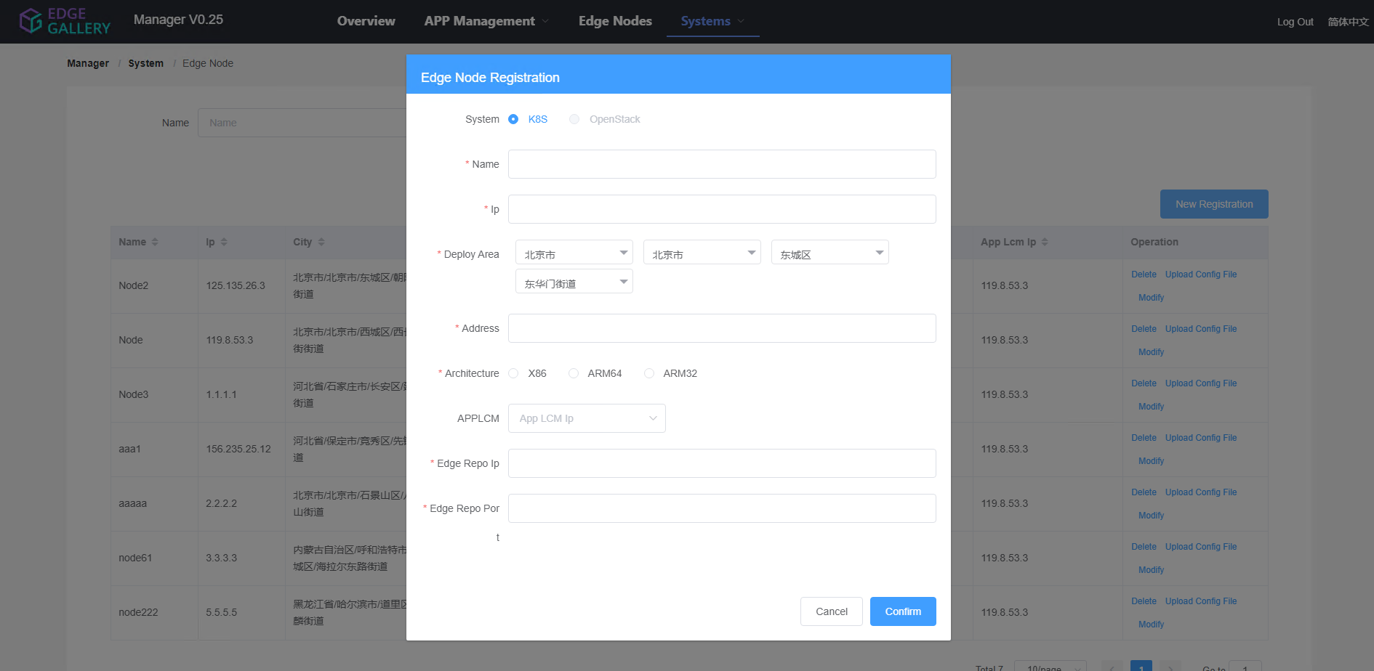
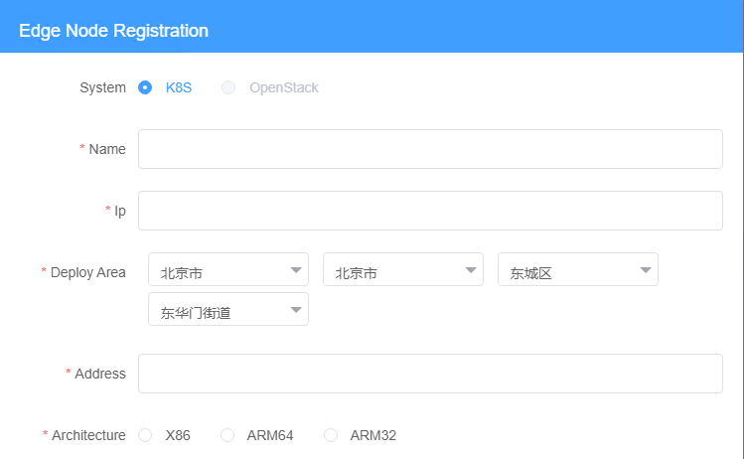

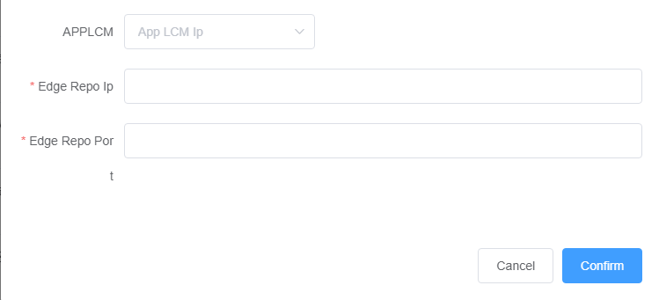
MECM-FE Design (TBD: YangYang)
HW Capabilities
Notes:
<number>

Slide 7
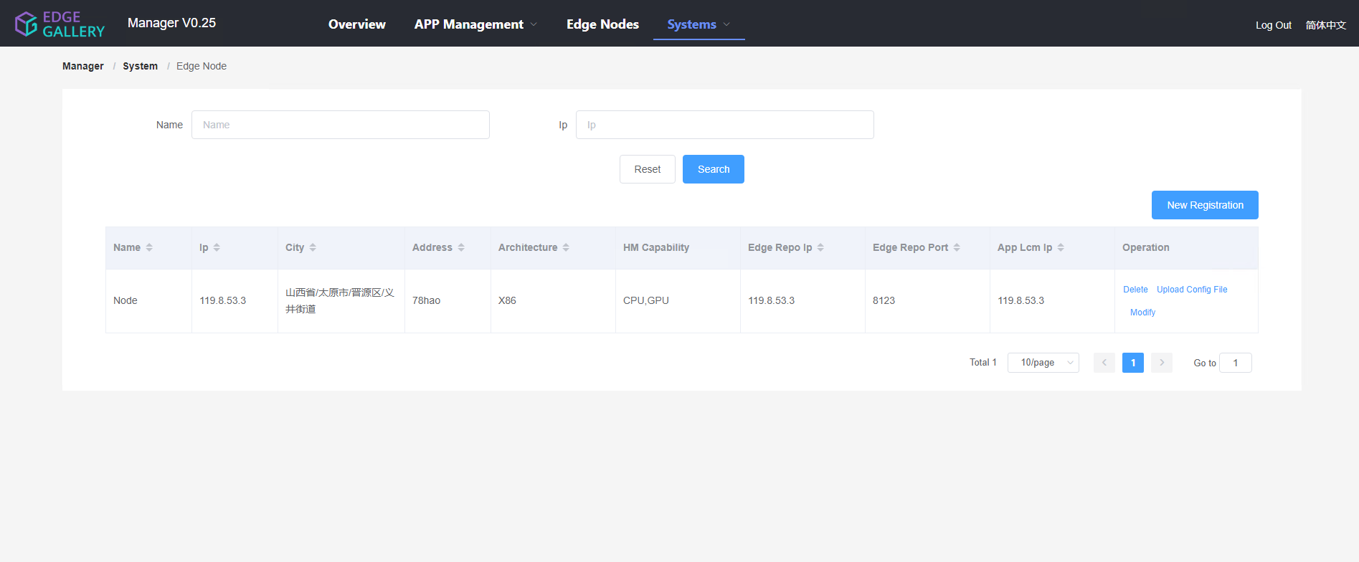
MECM-FE Design (TBD: YangYang)

Slide 8
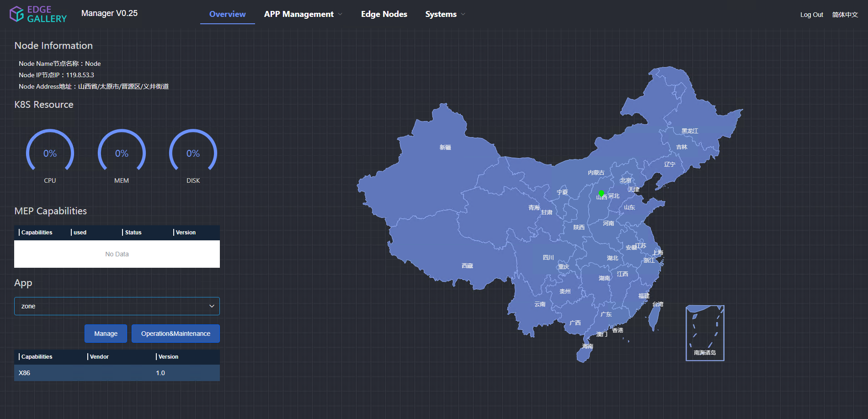

MECM-FE Design (TBD: YangYang)
Need to discuss what should be shown here
CPU,GPU
NA
NA
NA
Hardware capability
Status
Software capability
ExampleService
Active
1.0

Slide 9
Security Impact
Notes:
https://gitee.com/edgegallery/community/blob/master/Security%20WG/Tutorials/Gitee%20Pull%20Request%20Compliance%20Verification.md

Slide 10
Thanks

